Slide 1
Survey Analysis of Multi-Layer Perceptrons and Common Convolutional Neural Networks
CS 4375.003| Machine Learning | Presented by Julian Paulino

Slide 2

Project Goals
Discuss development of models
Relationship between each model
Foundational basis for new learners

Slide 3
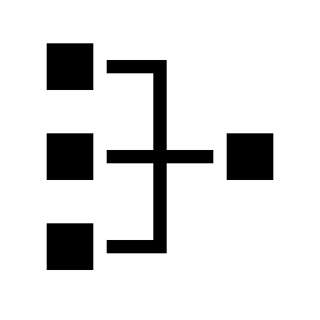
Introduction
Types of Models
Multi-Layer Perceptron
Convolutional Neural Network
LeNet5 CNN

Slide 4
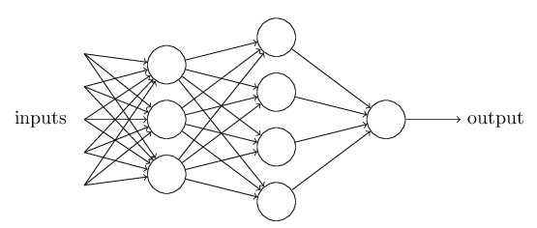
Multi-Layer Perceptron
Overview
Visualization of a basic MLP
Simplest form of Neural Net
Based on perceptrons by Rosenblatt
Strengths
Simple, versatile, straightforward
Weaknesses
Unscalable, computationally expensive
Image from M. Nielsen, http://neuralnetworksanddeeplearning.com/chap1.html

Slide 5
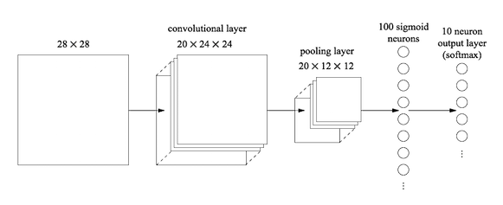
Convolutional Neural Net
Design
Convolutional Layer
Pooling Layer
Fully Connected Layer
SoftMax Output
Image from M. Nielsen, http://neuralnetworksanddeeplearning.com/chap6.html

Slide 6
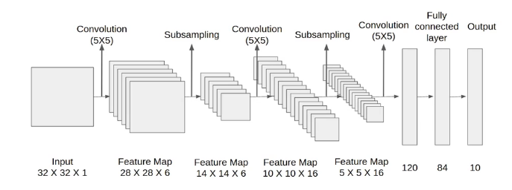
CNN: LeNet5
Type of Convolutional Net
Developed by LeCun et. al. in 1998
Focus on image recognition

Slide 7
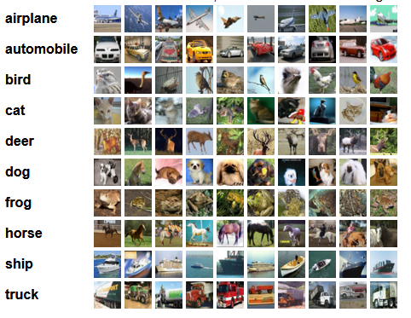
Experiment
Goal: Determine which aspect of a model most contributes to correctness
Models used
MLP, CNN, LeNet5
Datasets used
MNIST (handwritten digits)
Fashion-MNIST (grayscale clothing)
CIFAR10 (color, various classes)
Environment
Google Colaboratory
Image from https://www.cs.toronto.edu/~kriz/cifar.html

Slide 8
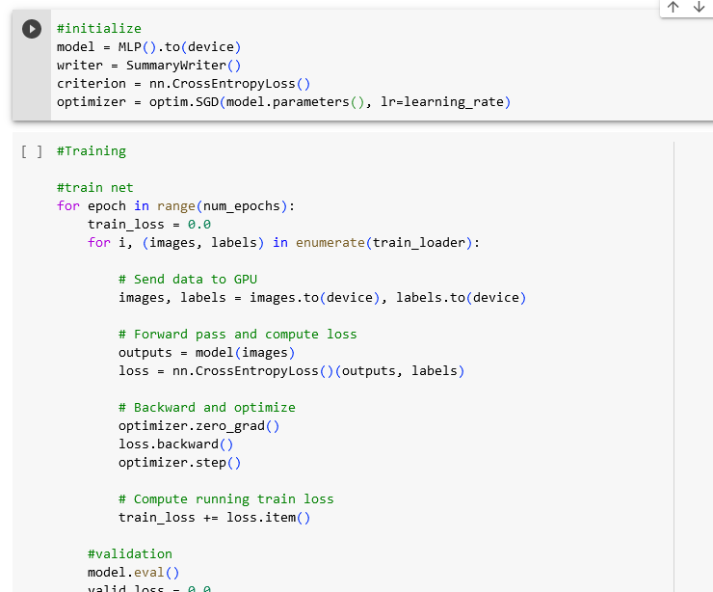
Procedures
All models comprised of the same code
Data formatting, hyperparams, training and testing loops
Only changes were to network class
All three models trained on all three datasets
Losses printed to tensorboard
Snippet of code used

Slide 9
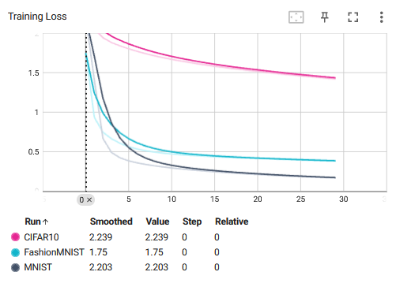
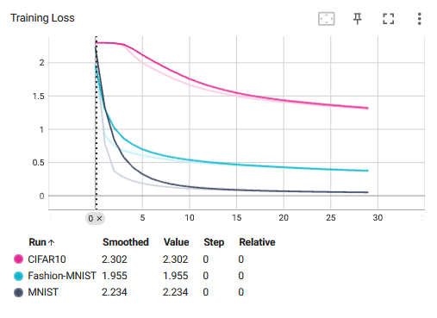
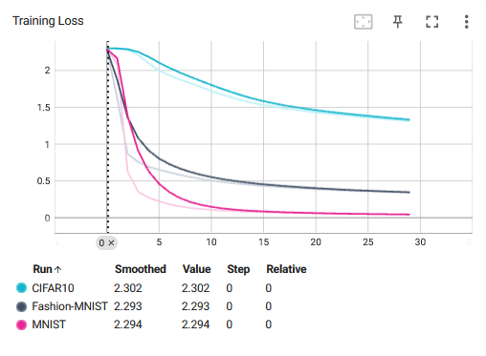
Results
For increasing levels of complexity, training progresses faster
MLP
CNN
LeNet5

Slide 10

Future Experiments
Analysis with more complex datasets, more modern architectures
See if repeating layers can improve performance
Format data tensors differently

Slide 11
References
[1] E. Mollik, “ChatGPT is a tipping point for AI,” Harvard Business Review, https://hbr.org/2022/12/chatgpt-is-a-tipping-point-for-ai (accessed May 10, 2023).
[2] B. Widrow and M. Hoff, “Adaptive Switching Circuits,” in 1960 IRE WESCON Convention Record, 1960, pp. 96–104, doi: 10.1109/WESCON.1960.62.
[3] Rumelhart, D. E., Hinton, G. E., & Williams, R. J. (1986). Learning representations by back-propagating errors. Nature, 323(6088), 533-536.
[4] LeCun, Y., Boser, B., Denker, J. S., Henderson, D., Howard, R. E., Hubbard, W., & Jackel, L. D. (1989). Backpropagation applied to handwritten zip code recognition. Neural computation, 1(4), 541-551.
[5] Raina, R., Madhavan, A., & Ng, A. (2009). Large-scale deep unsupervised learning using graphics processors. Proceedings of the 26th International Conference on Machine Learning (ICML), 873-880.
[6] Nvidia Corporation. (2008). NVIDIA CUDA Compute Unified Device Architecture Programming Guide. Retrieved from https://docs.nvidia.com/cuda/pdf/CUDA_C_Programming_Guide.pdf
[7] F. Rosenblatt, "The perceptron: A probabilistic model for information storage and organization in the brain," Psychological Review, vol. 65, no. 6, pp. 386-408, Nov. 1958. doi: 10.1037/h0042519.
[8] M. Nielsen, "Neural Networks and Deep Learning," [Online]. Available: http://neuralnetworksanddeeplearning.com/index.html. [Accessed: May 11, 2023].

